Slide 1
Legislative Health Care Workforce Commission
University of Minnesota
Health Professional Education Programs
Terry Bock
Associate Vice President and Chief of Staff
University of Minnesota Academic Health Center
August 25, 2014

Slide 2
AHC Professional Education Facts
One of the most comprehensive health sciences centers in the nation
Six schools: Dentistry, Medicine, Nursing, Pharmacy, Public Health, Veterinary Medicine, and a Center for Allied Health Professions
6,200 students in 62 programs (professional, graduate, undergraduate)
1,400 faculty
Educate / train 70% of the health professionals in Minnesota
Educate at over 1,700 sites across the state: hospitals, clinics, pharmacies, nursing homes, community agencies, and other sites
2
Notes:
We are one of the most comprehensive academic health centers in the country. This gives us real opportunities in terms of interdisciplinary education and training. We have six schools, offering 62 degree programs delivered at 1,600 sites throughout the state, to 6,400 students, and taught by 1,400 faculty.
For many of the professions we teach, we are the only educator in the state or region. Overall, we train 70 percent of the state’s health professionals with the only dental school between Milwaukee and Seattle, the only College of Pharmacy, the only veterinary medicine school in the state, the primary school for advanced practice nurses, the only public health school, and our Medical School educates more than 80 percent of the state’s medical students and more than half of the state’s medical residents in University programs.
In addition – the faculty in our schools who teach students also conduct $426 million in privately and publicly funded research with the goal of improving health and discovering treatments and cures. And many of our faculty also takes care of patients.
Why care for patients? Two reasons – it’s an important way to teach students by working alongside them – but also patient care supports the mission of the schools.

Slide 3
AHC Professional Education Programs
Professional Programs
Doctor of Medicine (MD)
Doctor of Pharmacy (PharmD)
Doctor of Dental Sciences (DDS)
Doctor of Veterinary Medicine (DVM)
Doctor of Physical Therapy (DPT)
Doctor of Nursing Practice (DNP)
Master of Occupational Therapy (MOT)
Master of Public Health (MPH)
Master of Healthcare Administration (MHA)
Graduate Programs: e.g., Bioethics (MS) , Health Informatics (MS, MHI, PhD), Nursing (MN)
Baccalaureate Programs:
Bachelor of Nursing (BSN), Bachelor of Dental Hygiene (BSHD), Bachelor of Dental Therapy (BSDT) , Mortuary Science (BS), Clinical Laboratory Science (BS)

Slide 4
Health Professions Education
Highly regulated through accreditation standards, licensure and certification requirements for practice
High workforce demand driven by an aging population, retirements, and health care reform
High number of applicants; high retention; and high “on-time” graduation rates
Lengthy time to educate and train health professionals: didactic and experiential
Clinical and experiential learning, including over 1,700 affiliated training sites across Minnesota and internationally
Competencies demonstrated through standardized patients and examinations
Use of simulation and technology for competency development
Interprofessional education and training

Slide 5
Length of Doctoral Education
Medicine, Nursing, Dentistry and Pharmacy
Medicine (MD)
Graduate Medical Education
CME
3-4 years
High School
~4 years
BS or BA Degree
4 years
Medical School
3-5 years
Required Postgraduate
Residency
1-5 years
Fellowship (Specialty)
Nursing (DNP)
PhD
CNE
3-4 years
High School
4-year Bachelor of Science in Nursing Degree
3-year Doctor of Nursing Practice in one of 13 specialties
Optional post-grad Cert.

Slide 6
Length of Doctoral Education
Pharmacy and Dentistry
Pharmacy (PharmD)
MS
PhD
3-4 years
High School
2-3 years
Undergrad
Study
4 years
Pharmacy School
CE
1-2 years Optional Postgraduate Residency or Fellowship
Dentistry (D.D.S.)
CE
3-4 years
High School
~4 years
BS or BA Degree
4 years
Dental School
Optional Postgraduate
(Specialty)

Slide 7
Required Clinical Hours per Student
Notes:
7
The training represented on this chart shows the number of hours of experiential education required for each of the health care professions within the AHC. Experiential education happens outside the traditional classroom under the direct supervision of a mentor/teacher. Hence, it is more akin to field training, and is the reason we have affiliation agreements with over 1000 community, clinic and hospital sites in the State of Minnesota. This model also allows us to recruit from communities and train in those communities, increasing the likelihood that the students will then practice in those communities. This model also provides us the opportunity to develop and test various models of care delivery that employ the various providers in different roles.
This experiential model also makes us interdependent with the communities, clinics, and health systems. Let me illustrate this interdependence a little more with the physician education/training model.

Slide 8
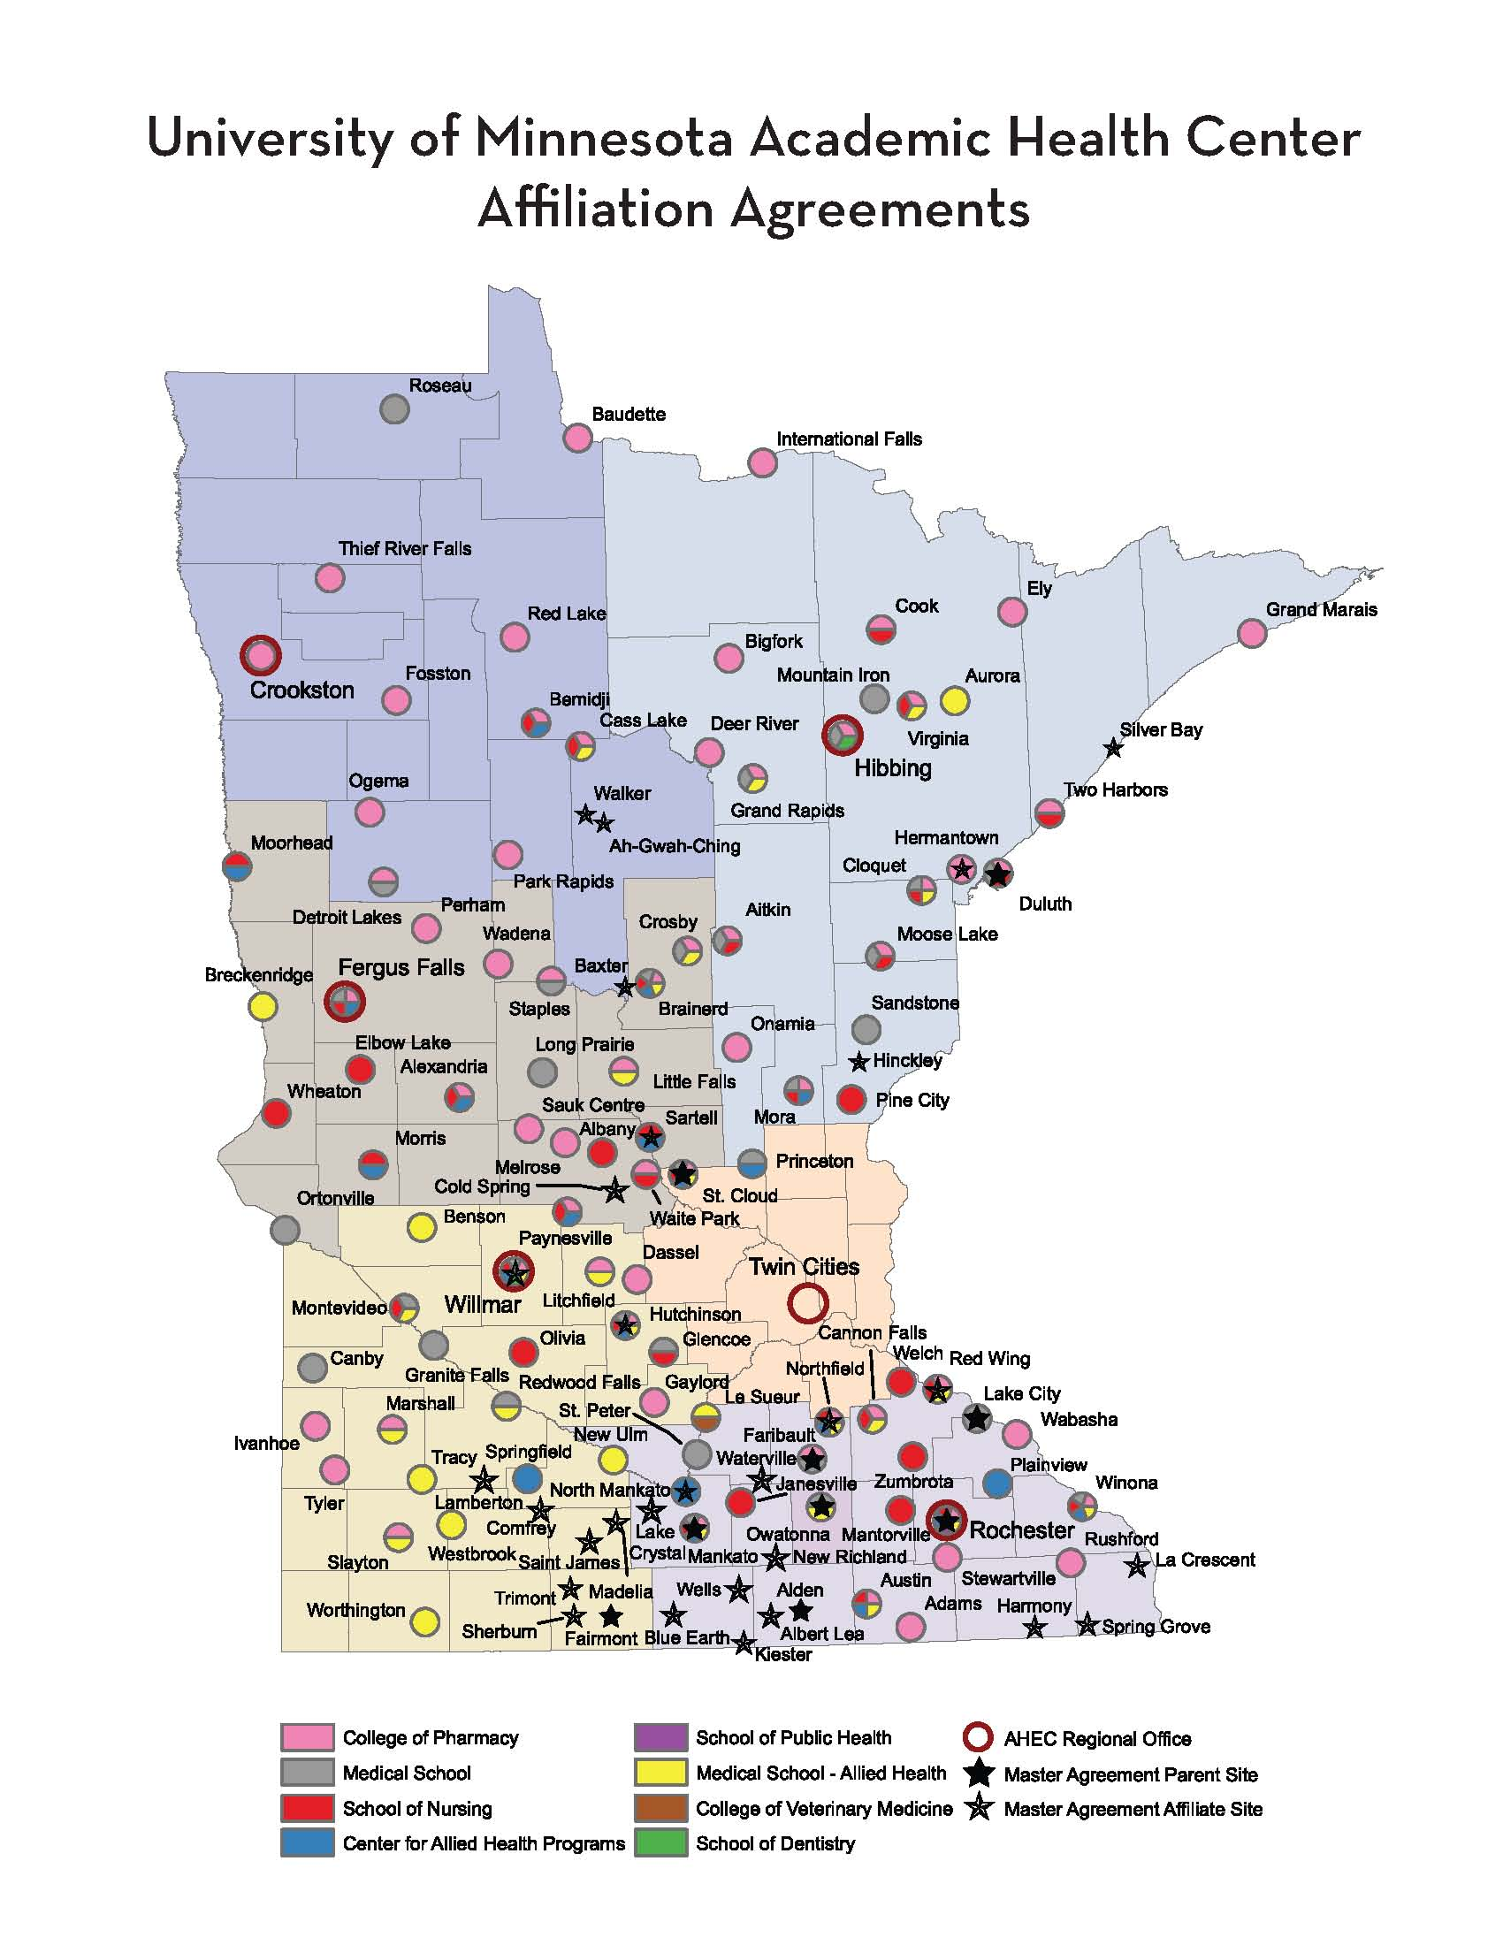

Slide 9
What We Have Done and Are Doing
Increased enrollments in all of our schools
Expanded programs
Pharmacy in Duluth
Nursing and Allied Health in Rochester
Nursing with Veterans Administration partnership
Doctor of Nursing Practice - 70% expansion 2014-2024
Developed pipelines
Minnesota Future Doctors
Rural Physician Associate Program (RPAP)
Area Health Education Centers (AHEC)
Health Careers Centers
UM Morris and UM Duluth MN collaborative Nursing programming
Developed new degree programs
Doctor of Nursing Practice and other Advanced Nursing programs
Dental Therapy
Revamping our curriculum
Team-based care and interprofessional education
Greater emphasis on simulation
Greater emphasis on prevention and wellness
9
Notes:
The University and the AHC have been working to address the health care needs of Minnesota for many years. We have increased enrollments to the extent we have been able, given the constraints of our faculty, teaching facilities, and training sites. We have expanded programs in Duluth and Rochester to train students in Greater Minnesota. And, we have developed and sustained pipeline programs to encourage high school and college undergraduates in health professional careers and to train our students (through RPAP and AHEC) in areas of health shortages to encourage them to practice in these communities when they graduate and complete their residency programs.

Slide 10
Entering Class Size
Health Professions Programs
 | 2000 N | 2012 N | Percent Change
School of Dentistry | 86 | 98 | ⬆ 14%
Medical School | 219 | 230 | ⬆ 5%
School of Nursing | 246 | 288 | ⬆ 17%
College of Pharmacy | 104 | 166 | ⬆ 60%
School of Public Health | 151 | 177 | ⬆ 17%
College of Veterinary Medicine | 76 | 99 | ⬆ 30%

Slide 11
University of Minnesota Health Professional Enrollments (2013-14)
Dentistry |  |  |  | Pharmacy
 | Dental Students | 412 |  |  | Pharmacy Students | 674
 | Dental Residents | 100 |  |  | Pharmacy Residents | 21
 | Dental Therapists | 30
 | Dental Hygienists | 96 |  | Public Health
 |  |  |  |  | Public Health Students | 1032
Medical School
 | Medical Students | 986 |  | Veterinary Medicine
 | Medical Residents | 910 |  |  | Veterinary Students | 474
Nursing
 | BSN (for RN) | 395
 | Masters in Nursing (RN) | 127
 | Doctor of Nursing Practice | 275
 | PhD in Nursing | 44

Slide 12
Average Student Debt by Degree
Degree | # of Graduates | % w / Loans | Average Loans
Doctor of Dental Surgery (DDS) | 109 | 85% | $208,005
Medical Doctor (MD) | 217 | 91% | $158,125
Doctor of Pharmacy (PharmD) | 157 | 94% | $133,490
Doctor of Nursing Practice (DNP) | 58 | 59% | $48,733
Master of Nursing (MN) | 66 | 92% | $48,506
Bachelor of Science in Dental Hygiene (BS) | 23 | 91% | $33,137
Bachelor of Science in Nursing (BSN) | 124 | 72% | $34,239

Slide 13
Major Challenges
Changing health care environment
Difficulty predicting future workforce needs and practice models
Growing disincentives for choosing and practicing primary care
Reduced state and federal funding for education and training: impact on tuition and student debt
Difficulty finding training/practice sites that model health care the way it should be delivered: working in teams with providers practicing at the top of their license
Access to clinical rotation sites for education
13
Notes:
Most predictions for future health care provider needs turn out to be wrong – for a couple of reasons. The pipeline to develop new providers is long and the landscape changes.
The reimbursement disincentives for primary care are a major challenge. Primary care physicians and other providers are not compensated as well as specialists. The reimbursement system is based on face time with patients rather than their health care. Our system is perverse – we are not paid for wellness.
Without adequate funding for education and training. We need to rely on tuition, and student debt continues to rise – creating another disincentive to choosing primary care. We are 4th highest in medical school tuition in the country. The same is true for all of our schools.
Finally, it is difficult (nearly impossible) for us to find clinical training and practice sites for our students and residents that actually model the way we think health care should be delivered. As much as we talk about new models of care, there are very few places where the models are practiced and even fewer where we can send our students and residents to train.

